Slide 1
Magnetic Fields in the Cosmic Web
and Synchrotron Emission
Dongsu Ryu (CNU),
Magnetism Team in Korea

Slide 2
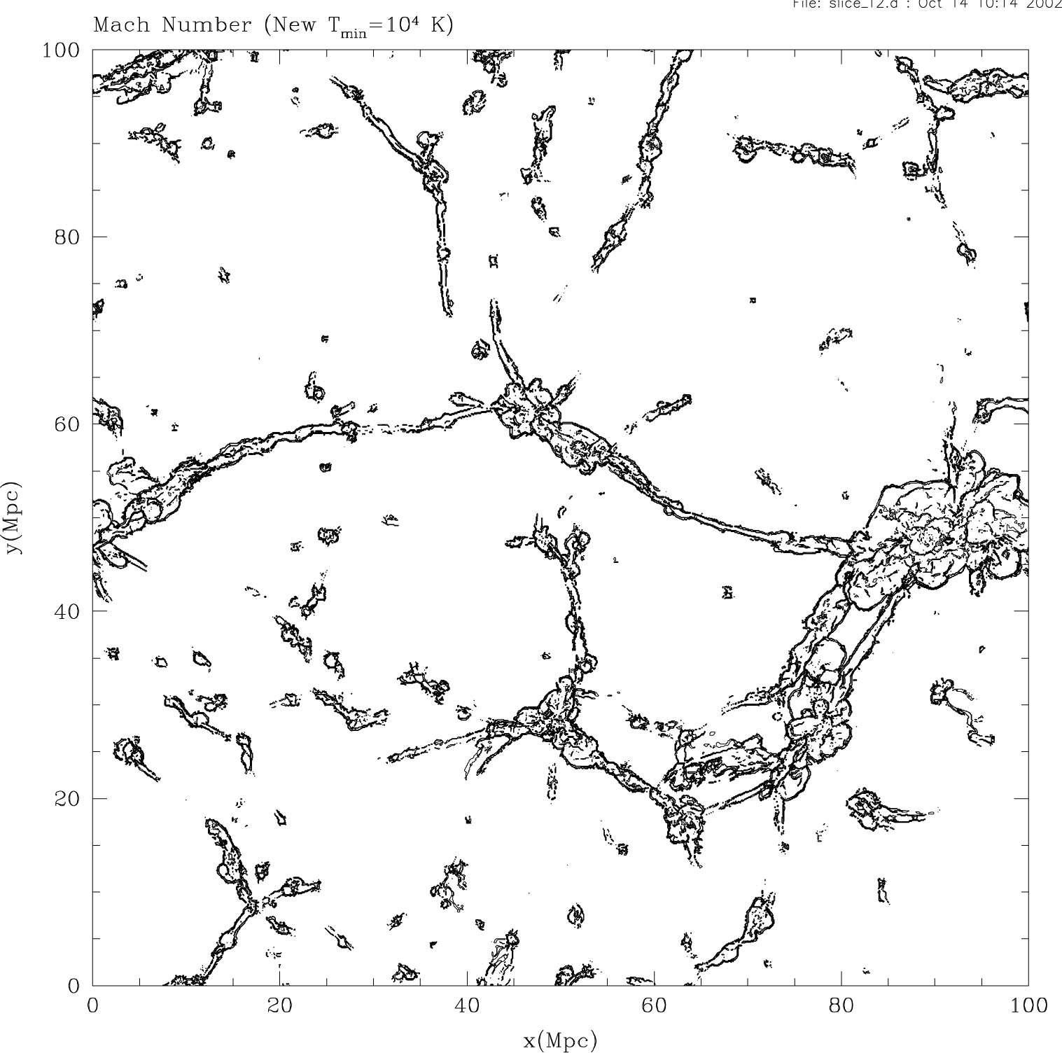
Magnetic fields in the intergalactic space
void regions:
B >~ 10⁻¹⁶ G (?)
100 h⁻¹ Mpc
filaments of
galaxies:
B ~ 10 nG
clusters of
galaxies:
B ~ a few μG
distribution of cosmological shocks

Slide 3
Exploration of magnetic fields in the cosmic web using the SKA
-> Faraday rotation measure
-> synchrotron
this talk

Slide 4
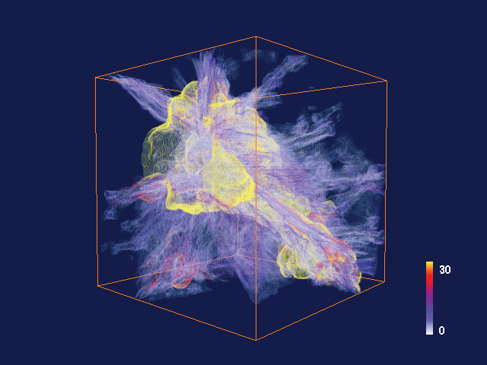
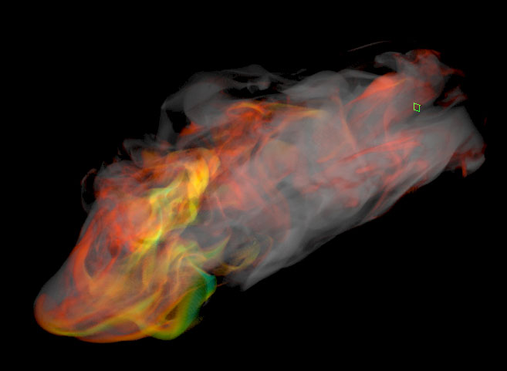
Sources of B and CRs
- formation of large-scale structure
-> shocks from merger, accretion, …
turbulence
- AGN outflows, galactic winds, …
- macroscopic, microscopic instabilities
Synchrotron radiation
requires
cosmic ray particles
+ magnetic fields
(Ryu et al 2003)
(Tregillis, Jones & Ryu 2004)

Slide 5
Overall picture for cosmological shocks
large-scale structure formation
other sources, such as AGNs of heat, CRs, turbulence and magnetic fields
gravitational collapse
& flow motions
shock dissipation
generation of heat
fresh acc. & re-acc. of CRs
genera. of magnetic fields
generation of vorticity
cosmological shocks
the main channel to flow the gravitational energy to the intergalactic medium
cascade into turbulence
shock
turbulent amp. of mag. fields
turbulent acceleration of CRs

Slide 6
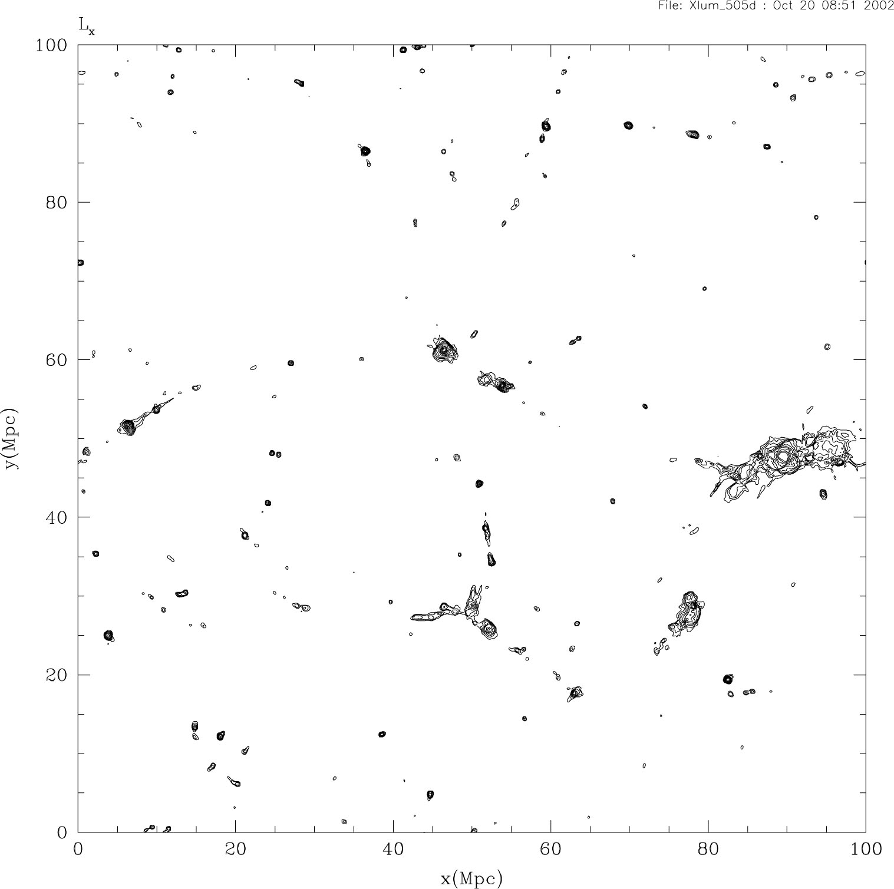
Spatial distribution of cosmological shocks
in the large-scale structure of the universe
(Ryu et al 2003)
X-ray emissivity
shock waves
cluster
filament
pancake
rich, complex shock morphology:
shocks “reveal” filaments and sheets (low density gas)

Slide 7
Turbulence
Vorticity generated at cosmological shocks
directly at curved shocks
at postshock
curved shock
preshock density
postshock density
preshock flow speed
unit normal to shock surf.
curvature radius of surf.
different jump of B (Bernoulli function)
baroclinity
by the baroclinic term
constant ρ
constant p
due to entropy variation induced at shocks

Slide 8
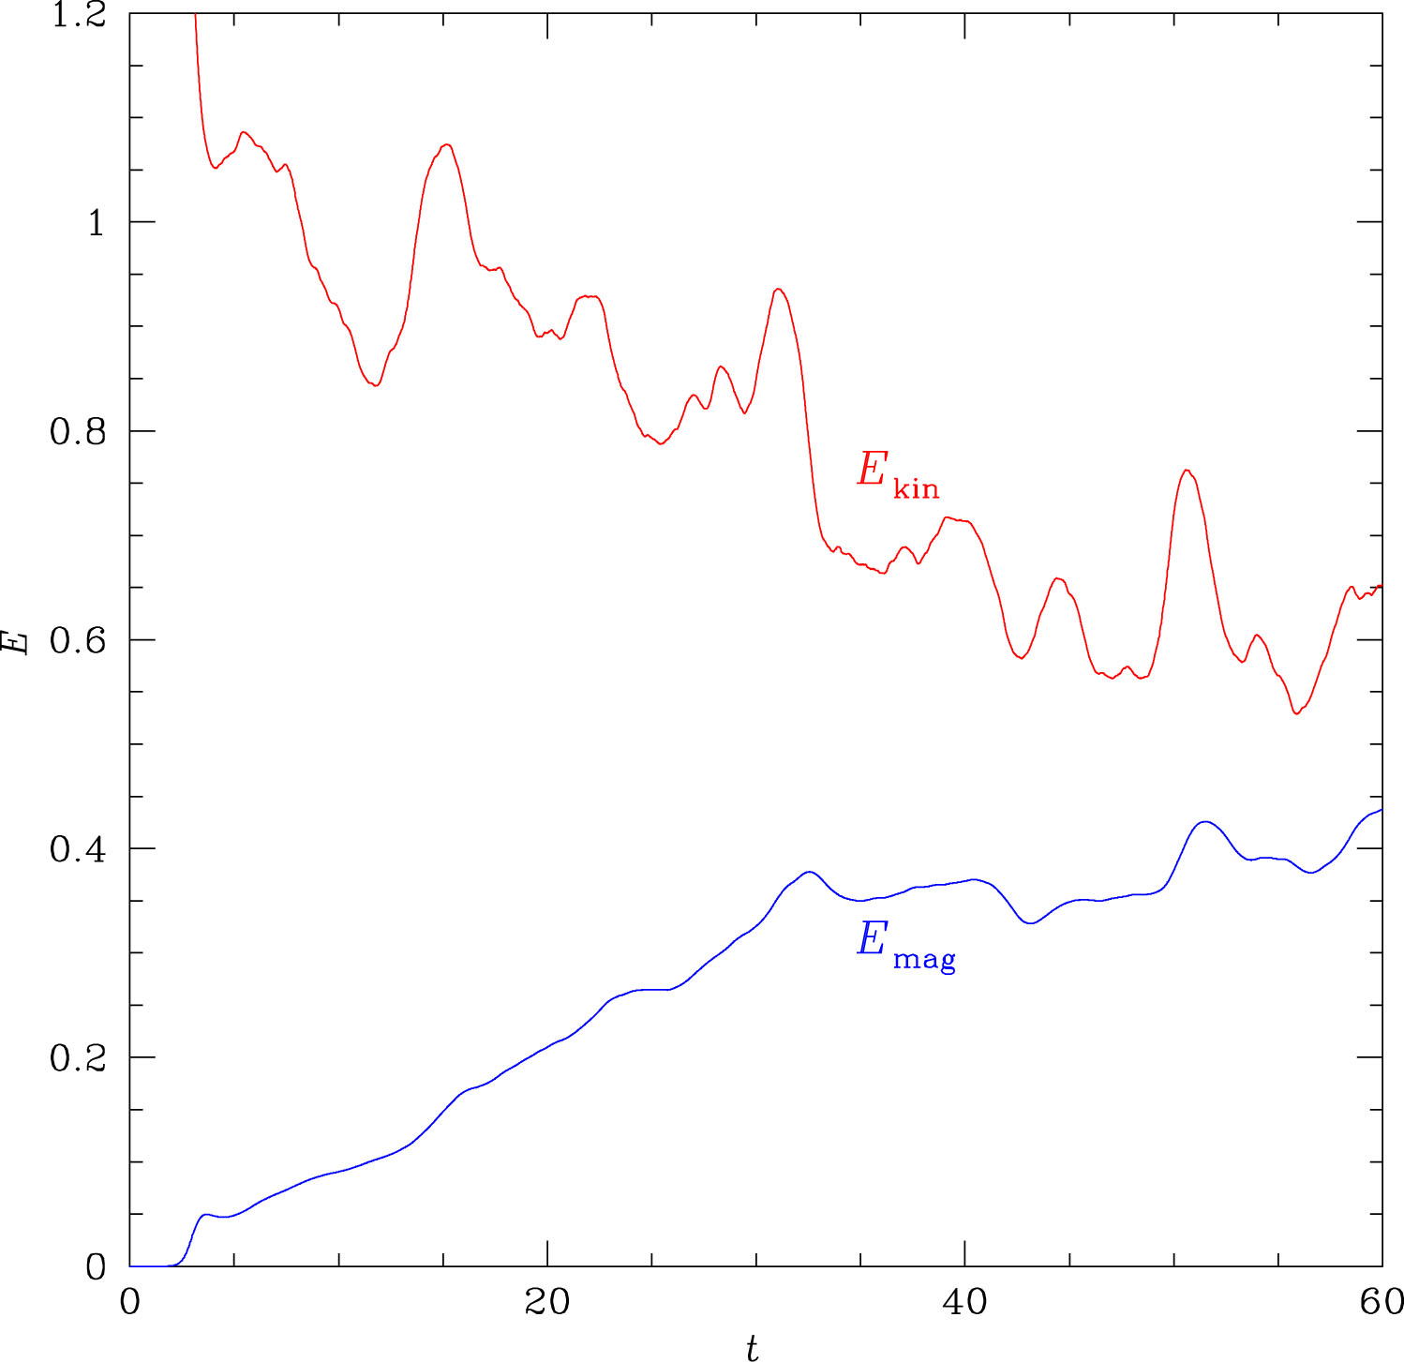
Simulation of turbulence dynamo or small scale dynamo (incompressible MHD)
(Ryu et al 2008)
(Cho, Ryu et al 2009)
vorticity ω
saturation
B
E_{mag} ~ 2/3 E_{kin}
at saturation
linear
exponential
20
40
60
80
t_{turn-over} ~ 1/ω
t/t_{turn-over}

Slide 9
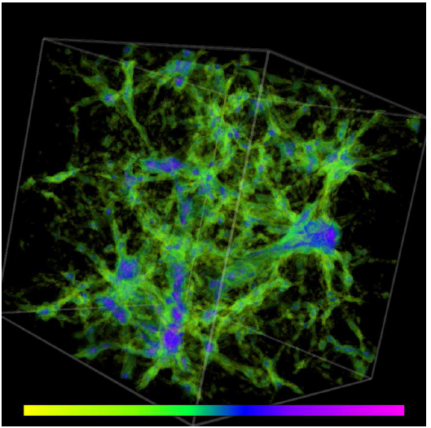
Resulting magnetic fields in the large-scale structure of the universe at z = 0
(Ryu et al 2008)
averaged magnetic field
strength at z = 0
magnetized cosmic web
inside clusters
<B> ~ a few μG
outskirts of clusters (T > 10⁷ K)
<B> ~ 0.1 μG
in filaments (10⁵ K < T < 10⁷ K,
or WHIM)
<B> ~ 10 nG
energetics
distribution of the intergalactic magnetic field in a (~100 h-1 Mpc)³ box
10⁻¹² G
10^{-8.5} G
10⁻⁵ G

Slide 10
Cosmic rays accelerated at cosmological shocks
key ideas behind DSA
(diffusive shock acceleration)
- Alfven waves in a converging flow
act as converging mirrors
→ particles are scattered by waves
→ cross the shock many times
“Fermi first order process”
shock front
particle
u₁
u₂
energy gain
at each crossing
converging mirrors
downstream
upstream
shock rest frame

Slide 11
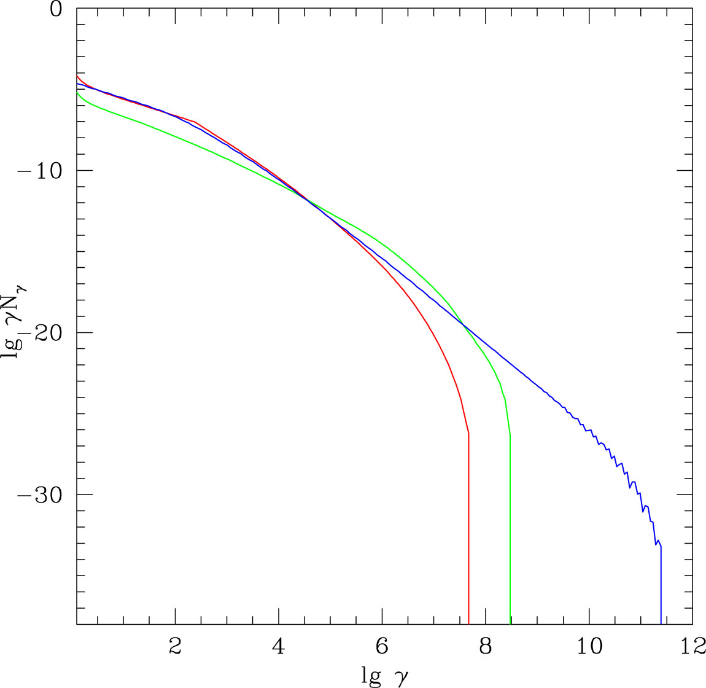
cosmic ray protons (accelerated at shocks)
secondary cosmic ray electrons (created through p-p)
Resulting spectrum of CRs
primary cosmic ray electrons (accelerated at shocks)
the ratio of E_{CRe}/E_{CRp} at shocks is arbitrary in this plot

Slide 12
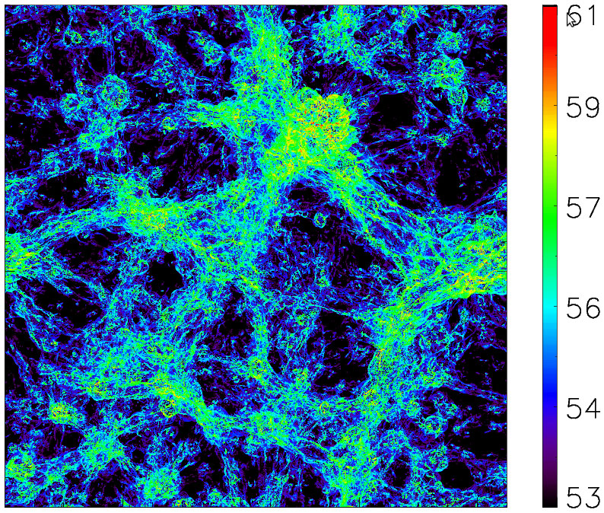
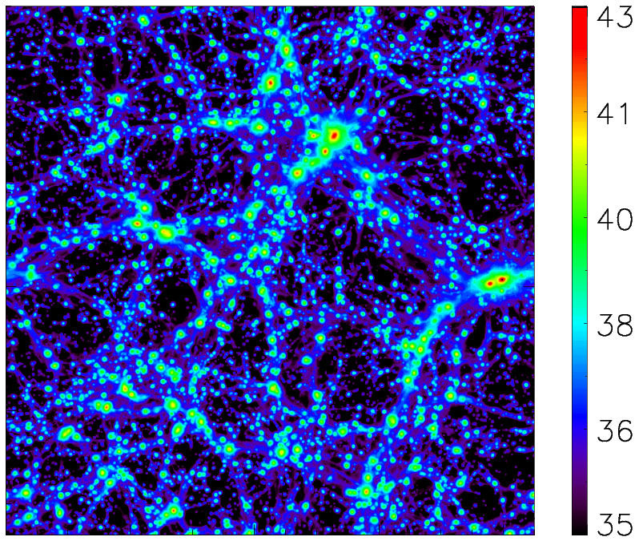
Observation of synchrotron in the LSS of the universe II
In the cosmic web: synchrotron from primary electrons -> traces shocks
area of the region – (85 h⁻¹ Mpc)² projected over the depth of 85 h⁻¹ Mpc
synchrotron (CRe + B)
thermal bremsstrahlung
- strength of ~ 1 – 0.1 of the Galactic foreground toward poles ?
- to be confirmed through correlation with diffuse X-ray ?
but separation of a few Mpc ?
- continuum in EMU and LADUAM ?
- another foreground to EoR HI 21cm ?

Slide 13
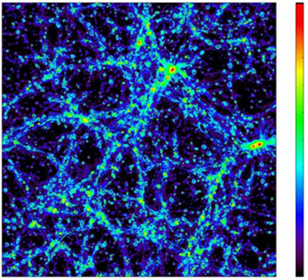
Observation of synchrotron in the LSS of the universe II
synchrotron from secondary electrons -> traces density peaks
area of the region – (85 h⁻¹ Mpc)² projected over the depth of 85 h⁻¹ Mpc
synchrotron (CRe + B)
thermal bremsstrahlung
- an order of magnitude smaller than that from primary electrons ?
- to be confirmed through correlation with galaxies ?
synchrotron from galaxies ?
- continuum in EMU and LADUAM ?
- a foreground to EoR HI 21cm ?

Slide 14
Numerics
maximum Lorentz factor of CR electrons accelerated at shocks
peak frequency of synchrotron from mono-energetic CR electrons with ge
frequency of HI line

